Slide 1

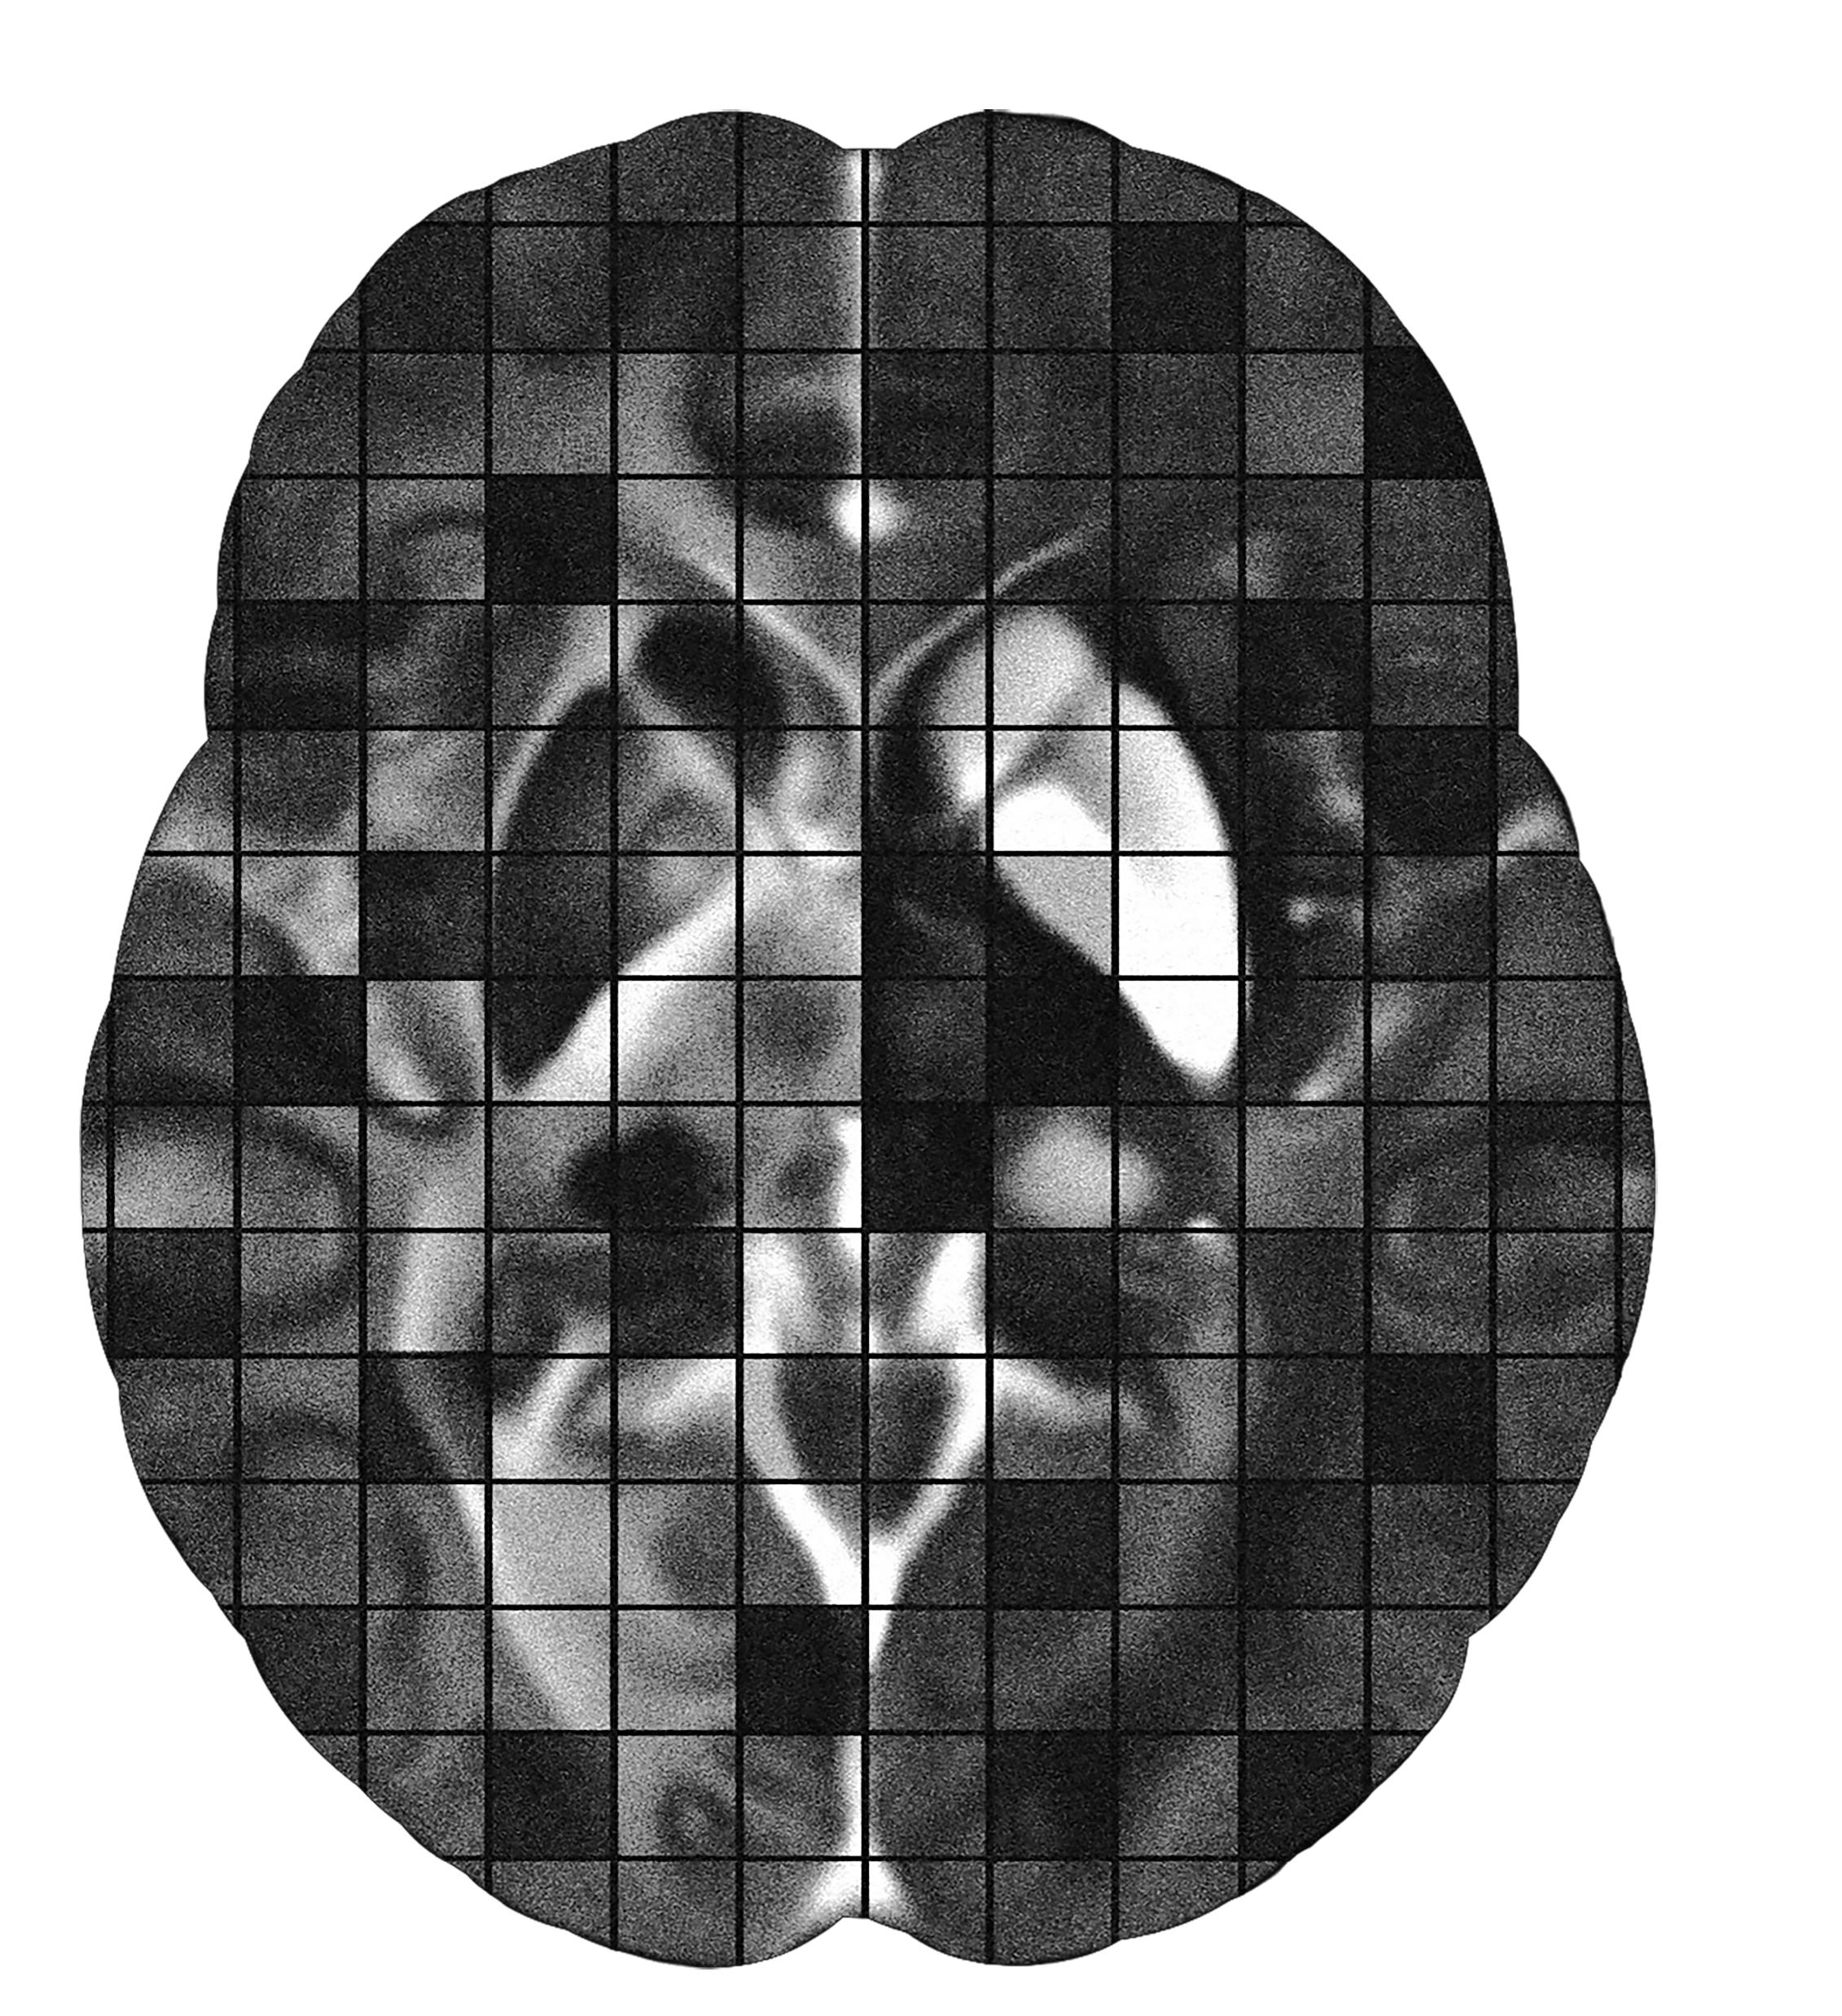
삼성 DS²과정 프로젝트
Image Restoration Challenge
Jongho Lee, Ph.D
Laboratory for Imaging Science and Technology
Department of Electrical and Computer Engineering
Seoul National University

Slide 2
프로젝트, 프로젝트, 프로젝트 …

Slide 3
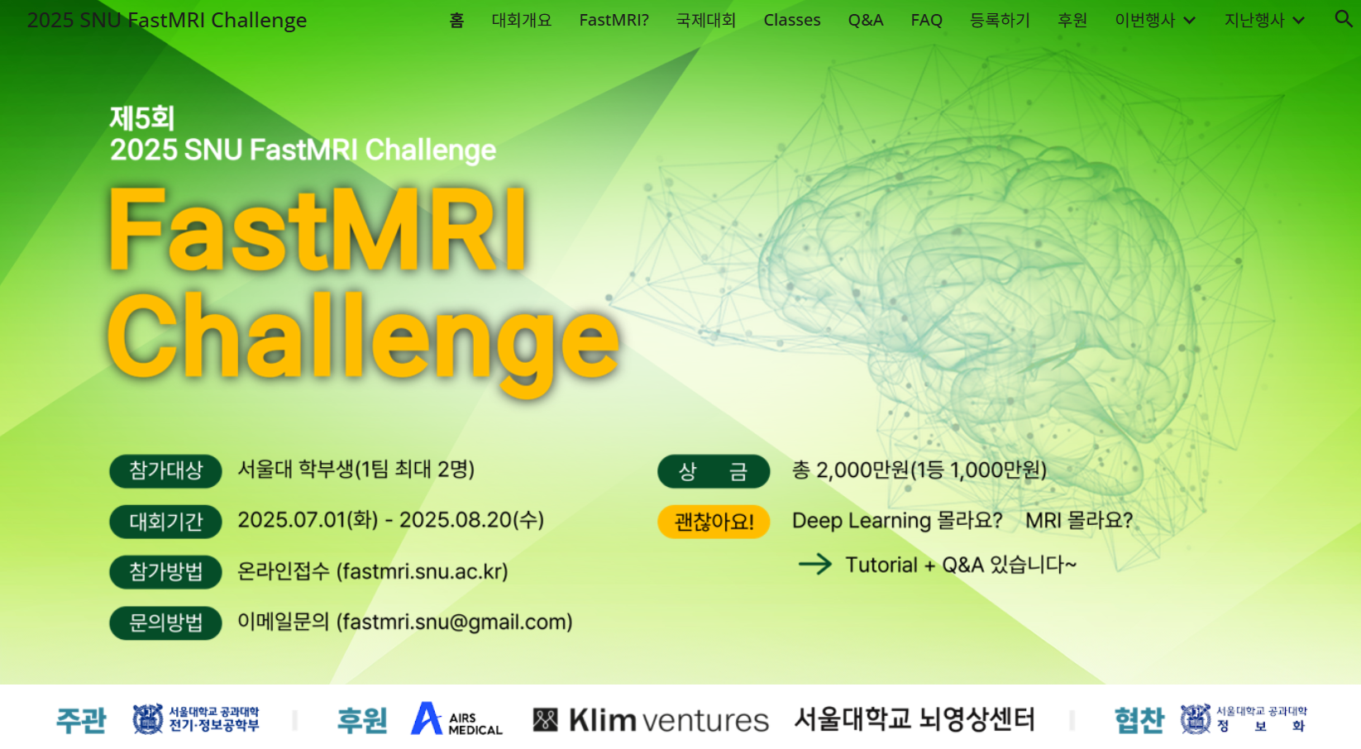

Slide 4
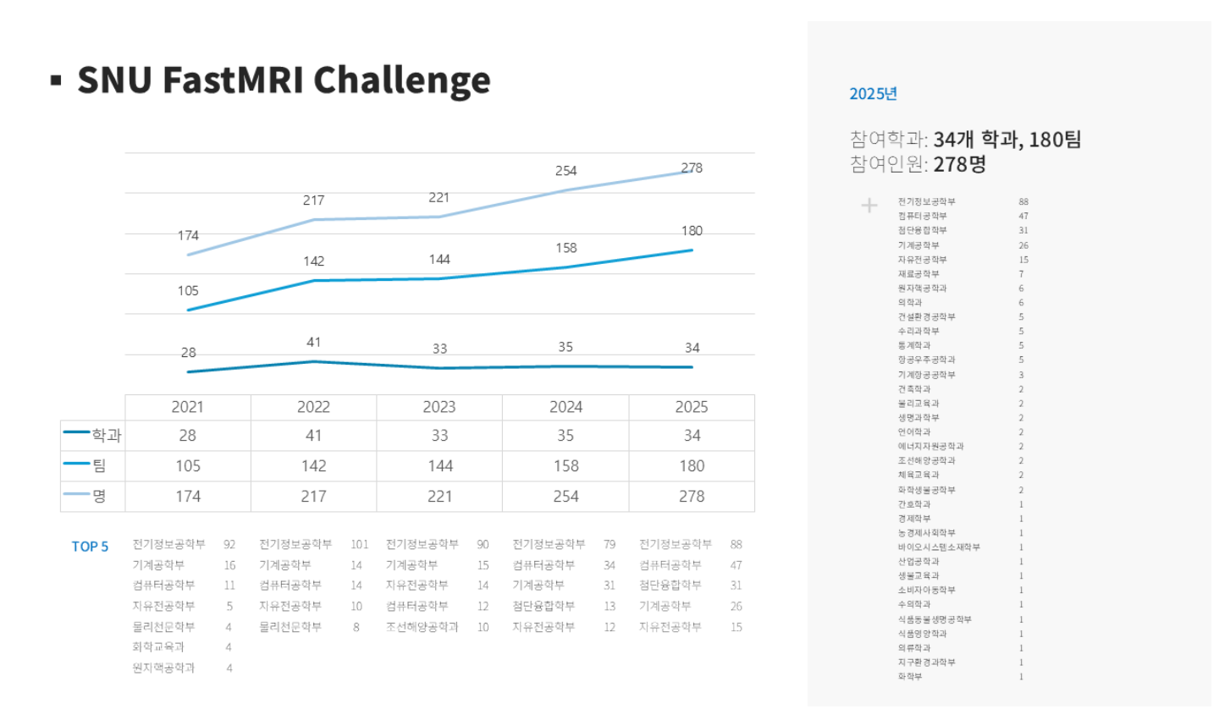

Slide 5
2026
제1회
2026 삼성DS²과정 Digital Image Processing Challenge
Semiconductor
Image Processing
Challenge
삼성DS²과정생
To be announced

Slide 6
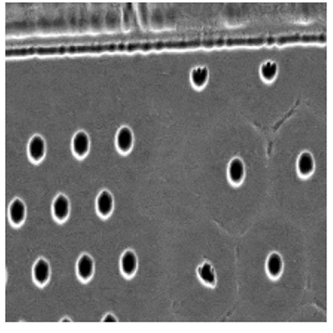
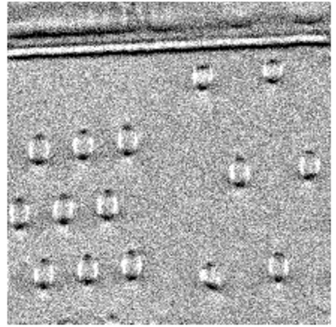
Aim of our challenge

Slide 7
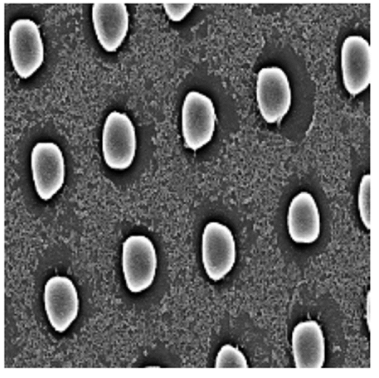
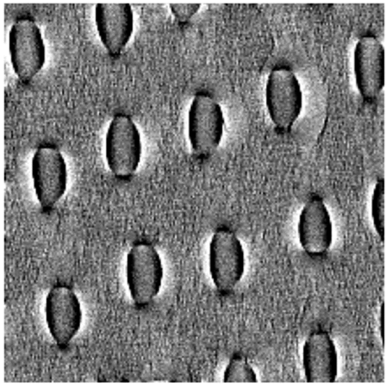
Aim of our challenge

Slide 8


Aim of our challenge

Slide 9



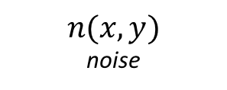



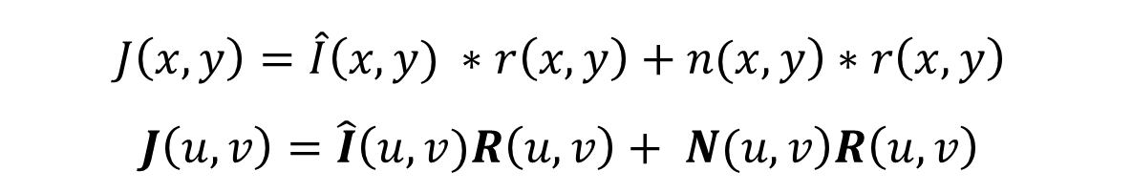
Basic model for degradation
Degradation
PSF: h(x,y)
(e.g blur)
Restoration
filter: r(x,y)

Slide 10
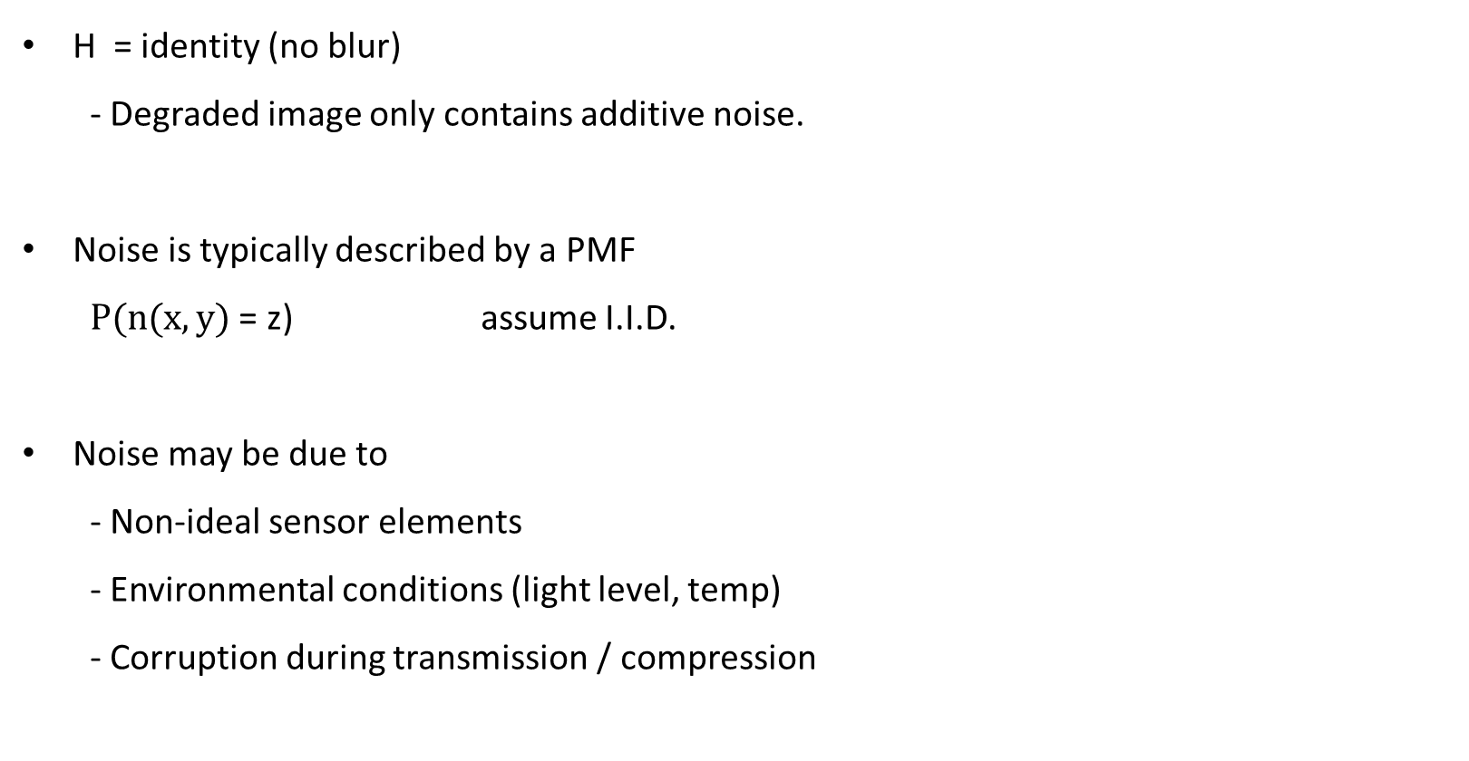
Easier case

Slide 11

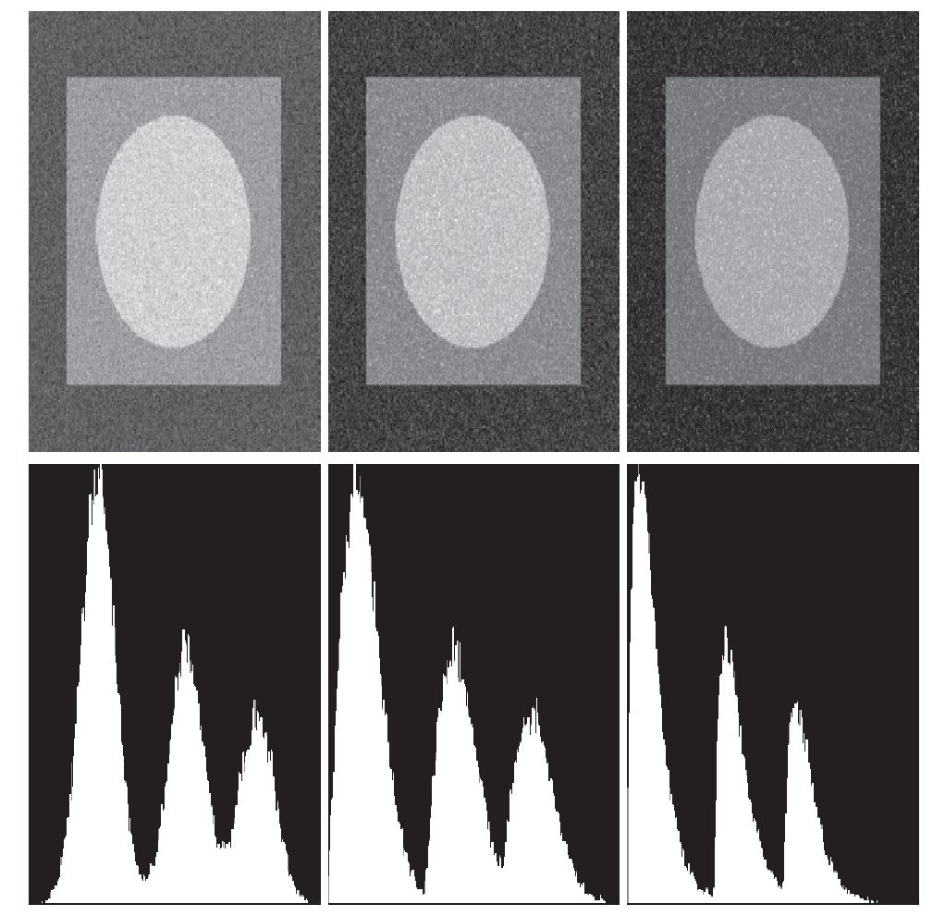
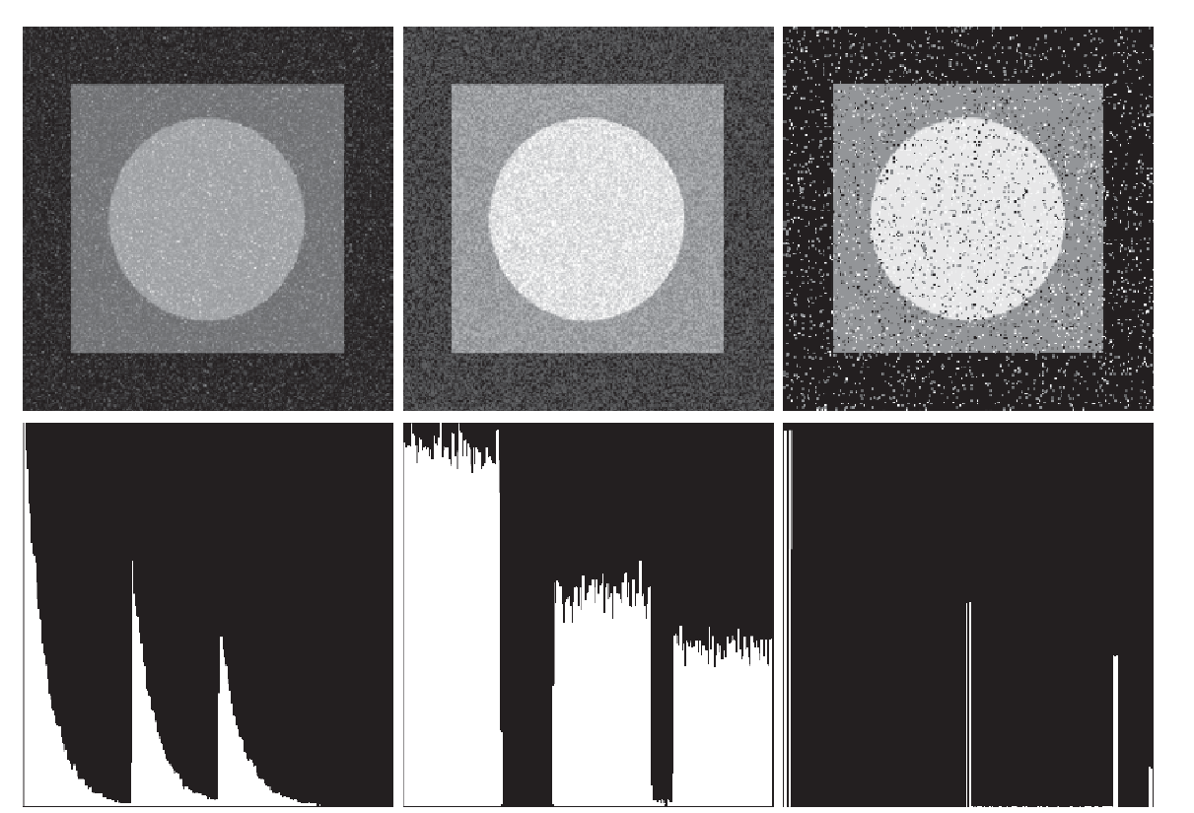
Noisy images
Gaussian
(Thermal noise)
Exponential
(laser imaging)
Noise distribution
Rayleigh
Uniform
Salt & pepper

Slide 12
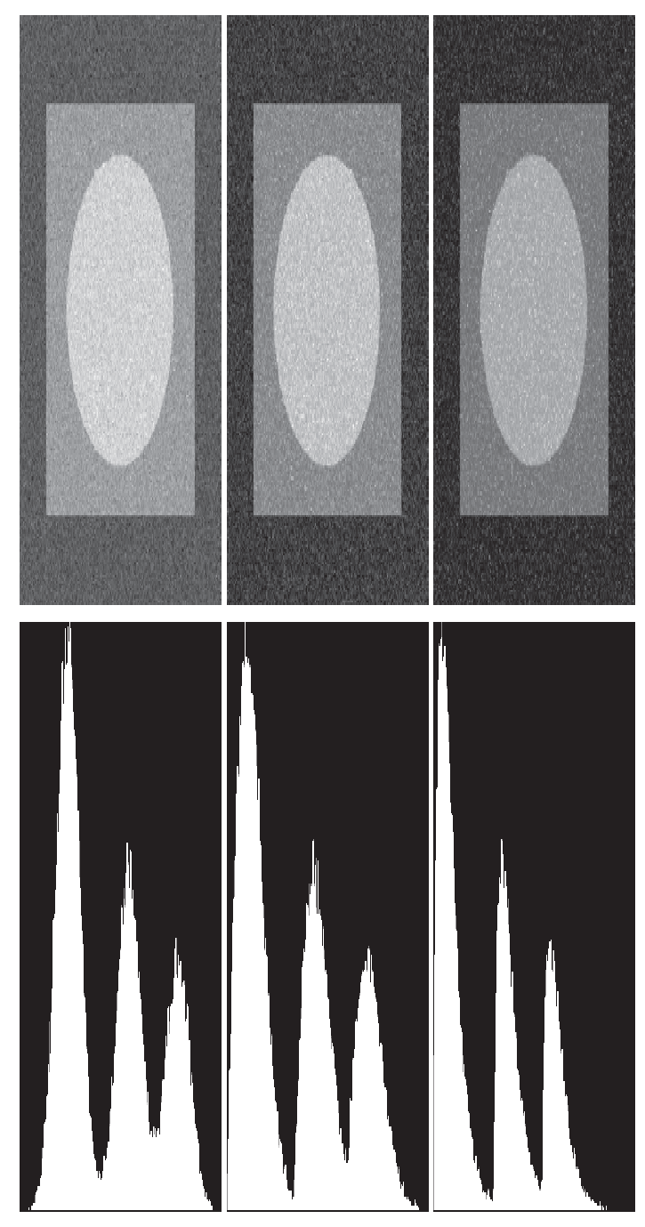
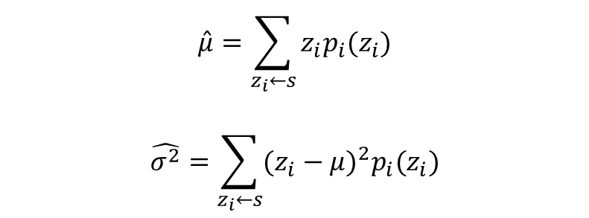
Determine noise type and power?
Typical ways
Find a region that should be flat (constant intensity)
Look at image histogram

Slide 13
Denoising
Low pass filter (image domain, Fourier domain)
Median filter for salt and pepper noise
Adaptive filter
Deep learning based denoising

Slide 14
Aim of our challenge

Slide 15
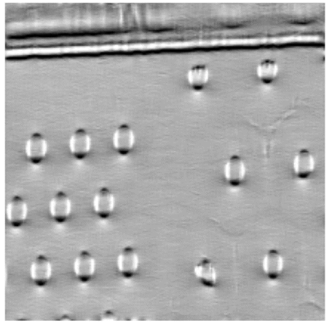
Aim of our challenge

Slide 16
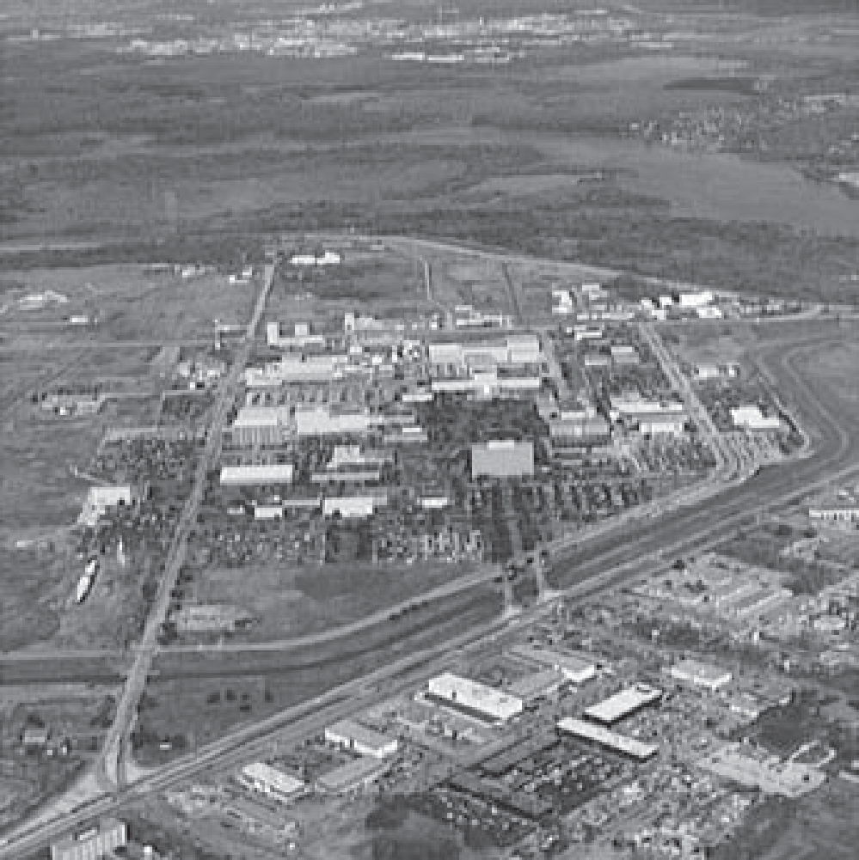
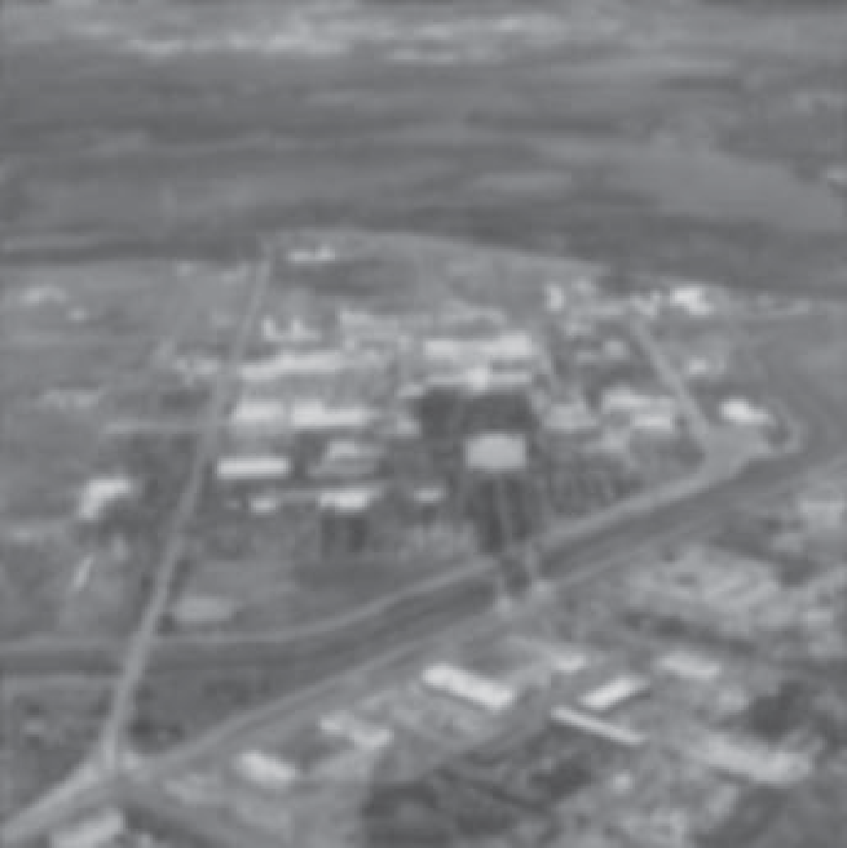
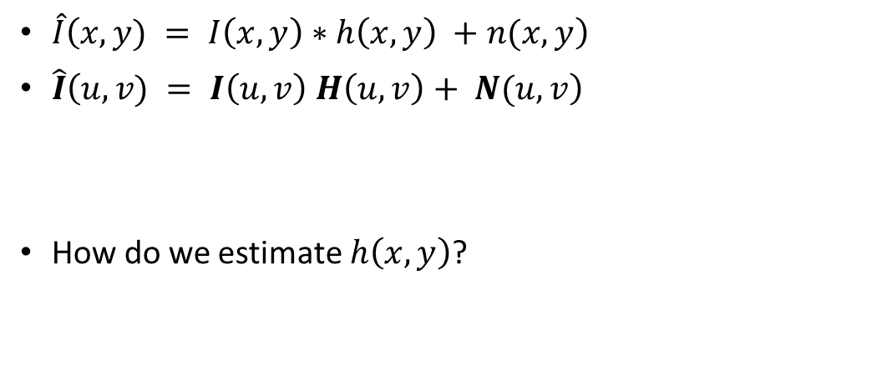
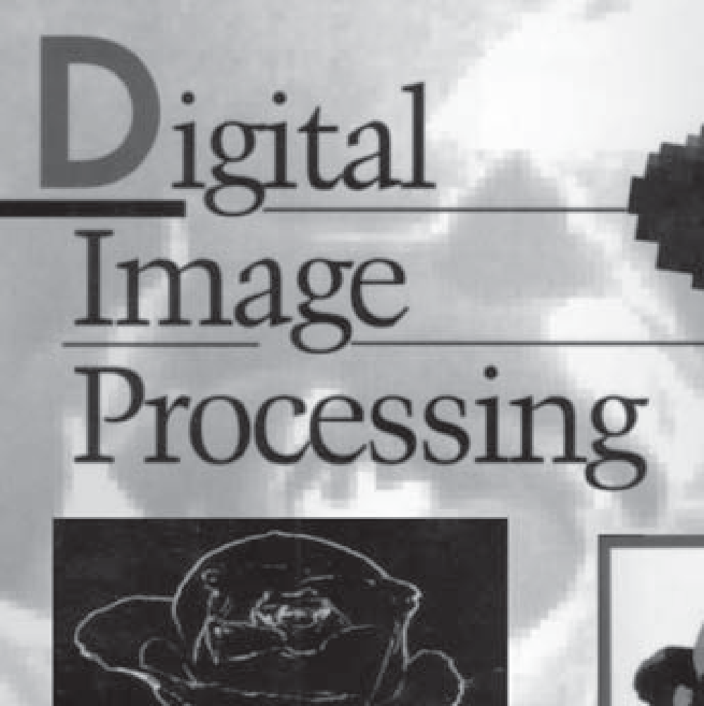

What happens when we also have degradation?
blur

Slide 17
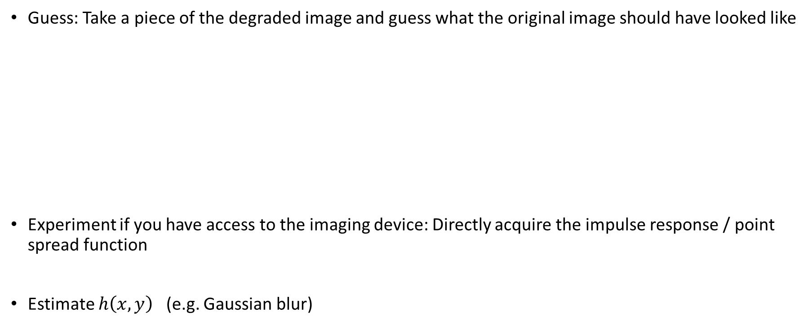
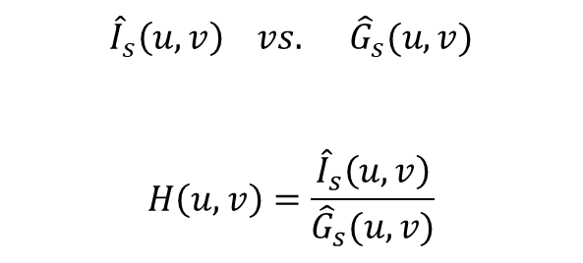
What happens when we also have degradation?
S = guess area
Manual guess

Slide 18
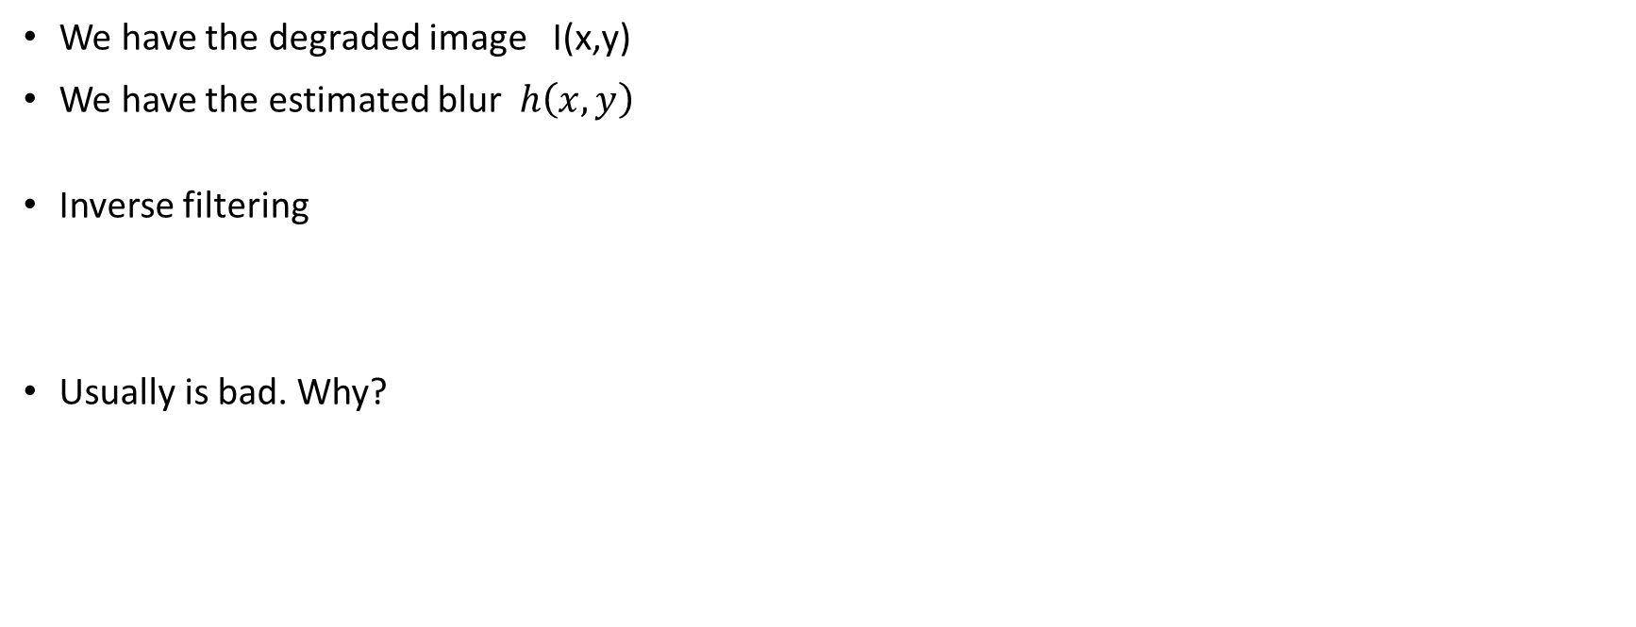

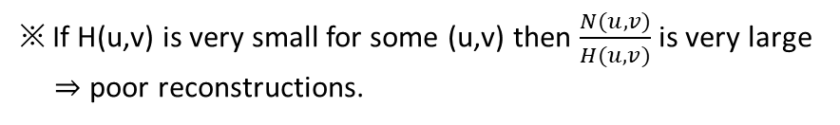
Inverse filtering

Slide 19
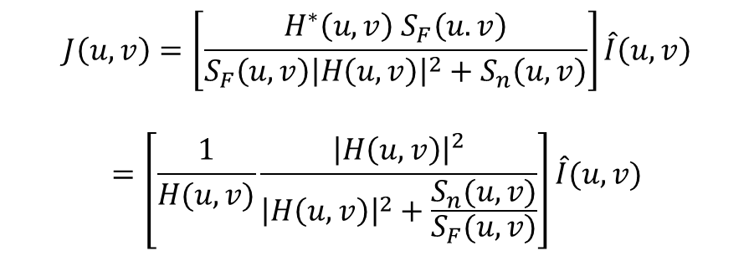
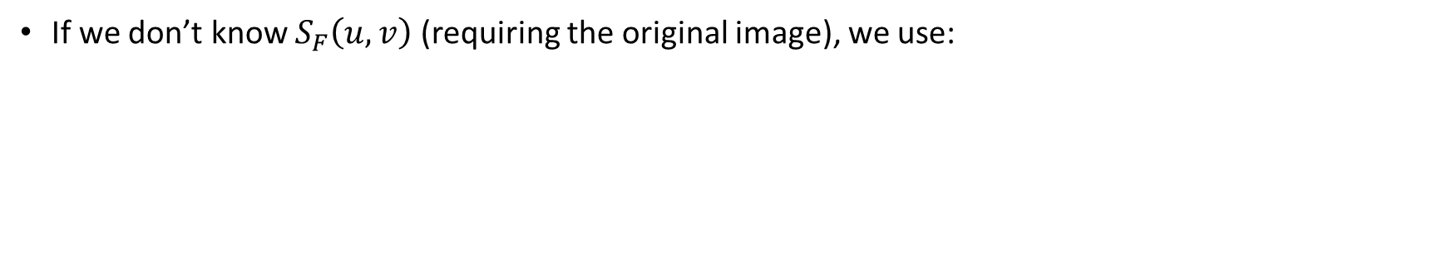

Wiener filter
Wiener filter: minimum mean-square error filtering
Tunable parameter

Slide 20
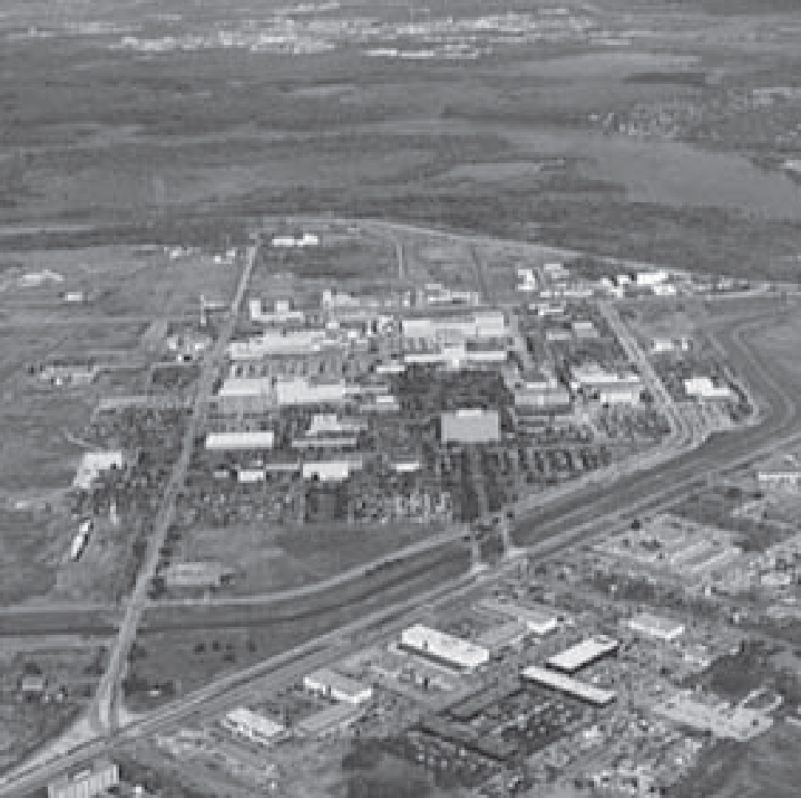

Wiener filter

Slide 21
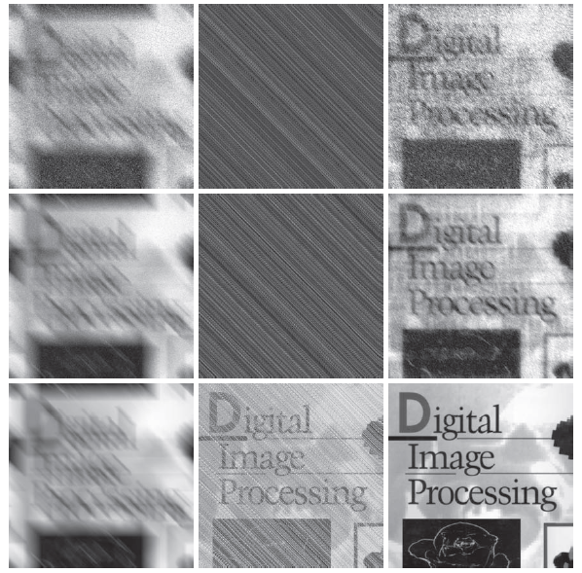
Wiener filter

Slide 22
Project overview
Goal: construct a pipeline to restore corrupted images into clean images
Dataset
Clean gray-scale images
Corrupted images generated by
Convolution with a 2D kernel
Addition of noise
Corrupted image
Restored clean image
Constructed pipeline

Slide 23
Project overview
Potential restoration strategies:
Classical Wiener filter
End-to-end neural network: train a single network to restore clean
Two-stage neural network: train a denoising network and a deconvolution network separately
Corrupted image
Restored clean image
Denoising + deconvolution
Corrupted image
Denoised image
Restored clean image
Denoising
Deconvolution

Slide 24
Challenge & approaches
In practical scenarios, clean ground-truth images are rarely available → A purely supervised approach is unrealistic in many applications
Possible approaches to consider:
Denoising: self-supervised learning, filtering, …
Deconvolution: leveraging multi-orientation information, regularization, thresholding, …
General approach: generating pseudo labels, and any other creative ways

Slide 25
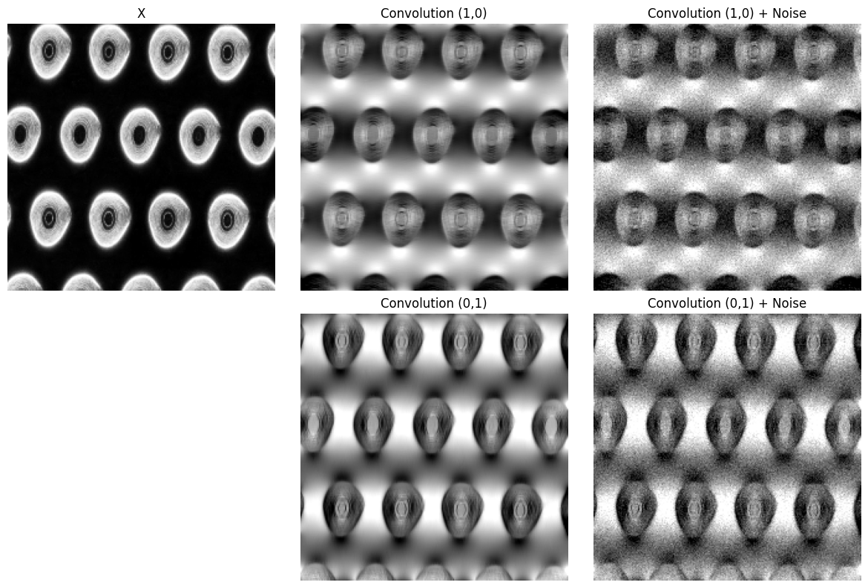
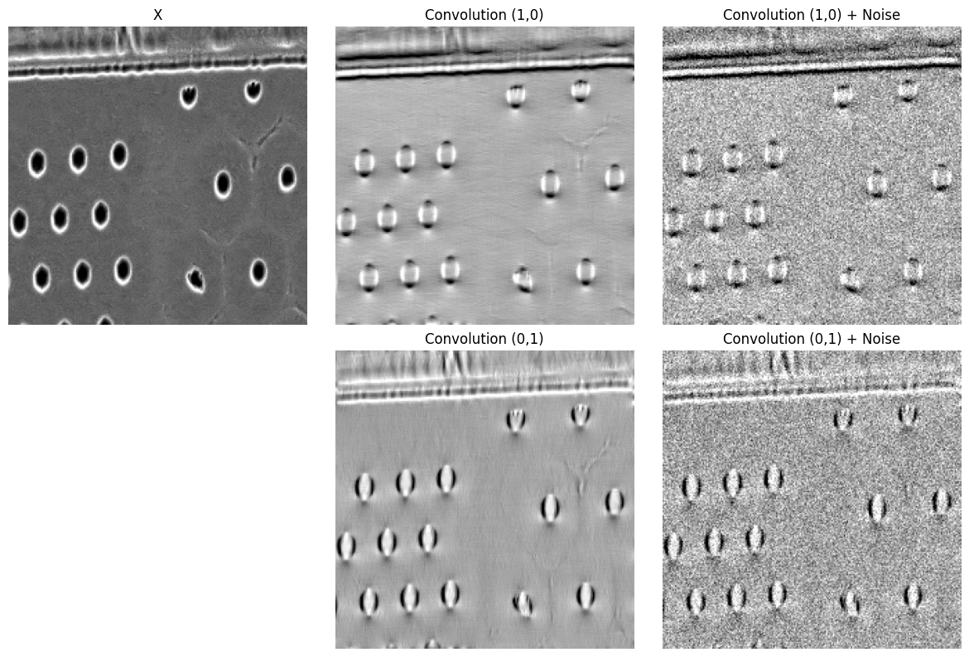
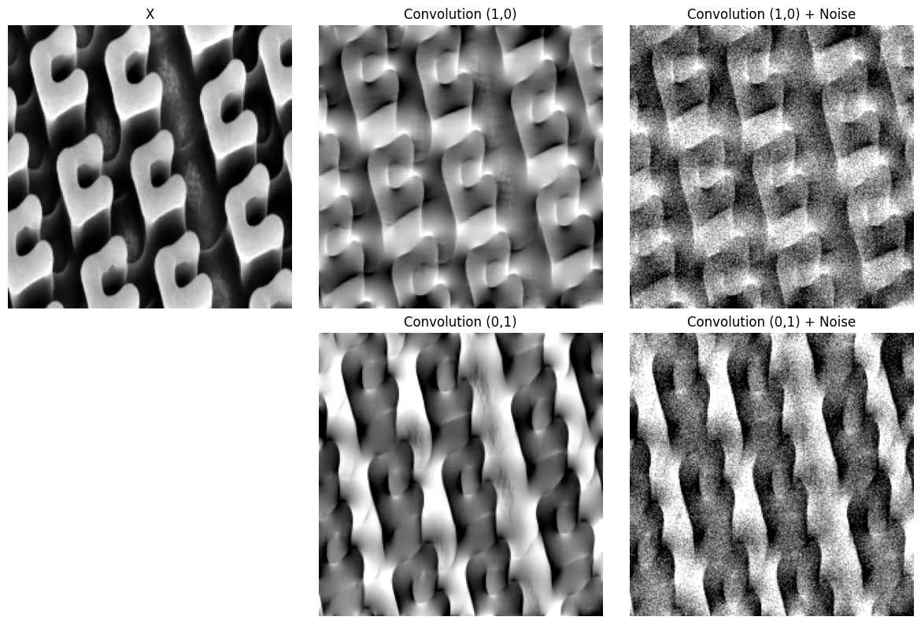
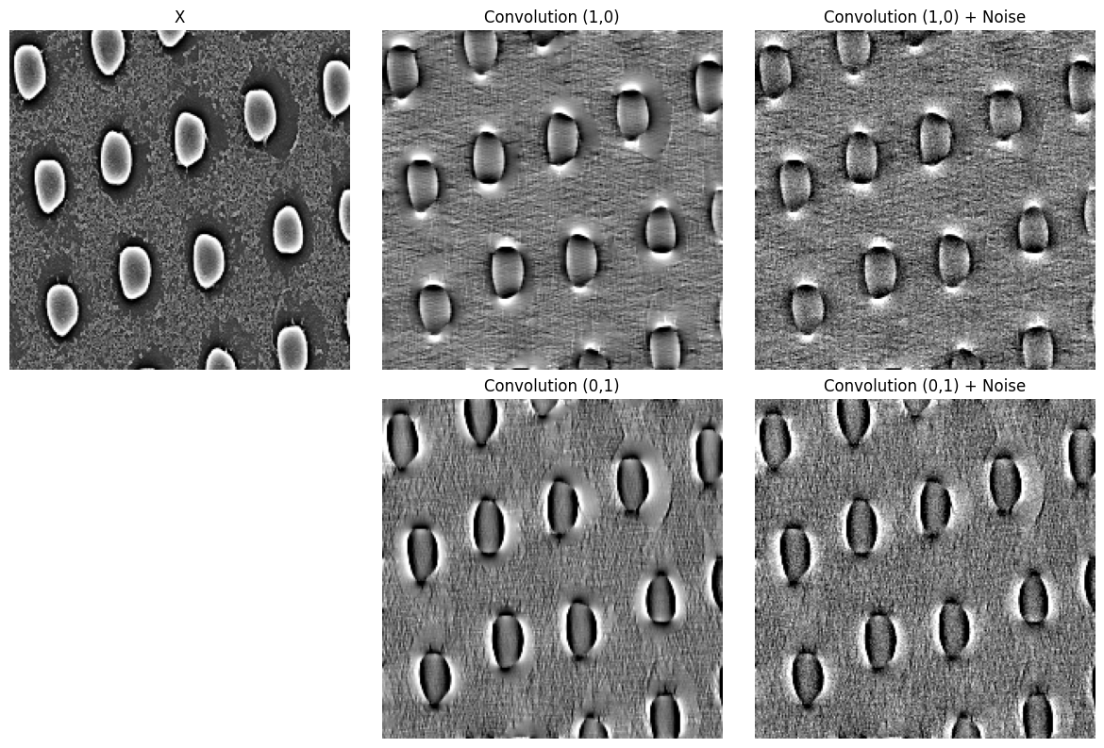
Multiple directional convolution images available for kernel estimation

Slide 26
Dataset
Train / validation dataset:
Clean images: 7,368
Forward corruption model:
2D dipole convolution (model is given)
Noise model (noise characteristic is not given)
For each clean image, you may synthesize corrupted variants, using the provided model
Test dataset:
Corrupted images only: 100 images (one per sample)
No clean labels provided

Slide 27
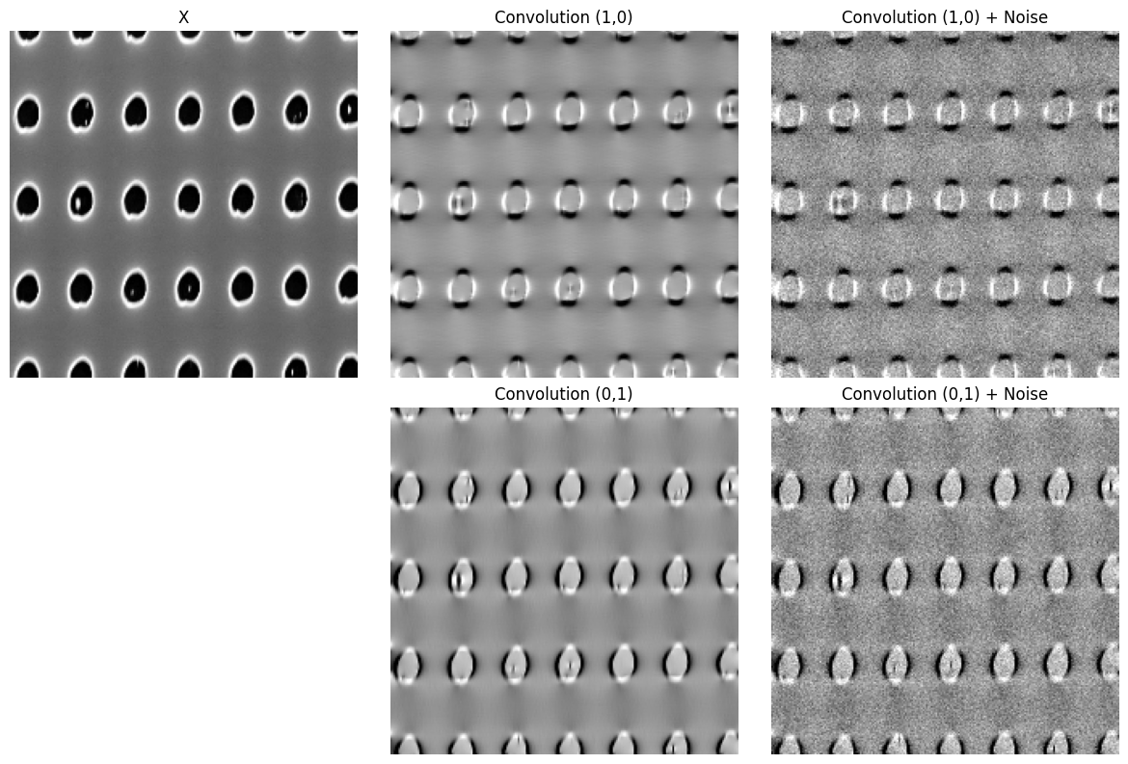
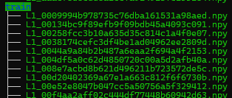

Training data
Train / validation dataset:
X is provided
Convolution & add noise can be performed via simulator

Slide 28
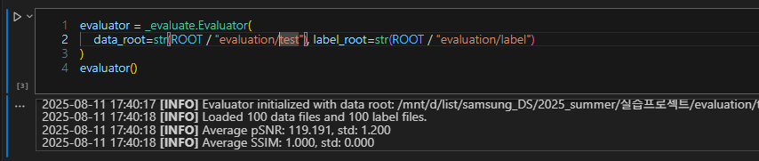
Test
Test dataset:
Corrupted images only: 100 images (one per sample)
No clean labels provided
Test code is provided with encrypted evaluator
Run test code with your test data on the Colab

Slide 29
Task
Use the forward model to synthesize training pairs
Construct a pipeline to restore corrupted images into clean images
You are free to explore any architectures or algorithms
Classical image processing
End-to-end approach (corrupted → clean)
Two-stage approach (denoising + deconvolution)
Self-supervised or label-free strategies (recommended for realism)
Etc.
Requirements:
For each clean image, you may generate up to 6 dipole kernel orientations.
For each orientation, you may generate up to 2 noisy images.
Do not exceed 12 corrupted images per clean image (6 orientations × 2 noises)

Slide 30
Evaluation
Metric (on test dataset)
On test dataset
PSNR, SSIM
Presentation
Explain your overall pipeline clearly
Show example restoration results (before/after).
Justify why you chose your specific method.
Label-free pipelines will receive partial bonus consideration.

